Slide 1
3. Color image coding
Yi-Shin Tung
National Taiwan University

Slide 2
Multi-level image coding
A standard image compression method is needed for interoperation among photovideotex, desktop publishing, graphic arts, facsimile…
  Exchange of images across application boundaries.
  Standardization provides economies of scale for VLSI solution.
Goals of JPEG
  State-of-the-art compression rate (1991) over a wide range of image quality ratings
  Applicable to handle all kinds of continuous-tone images
  Various operational modes suitable for different applications.
  Tractable computational complexity for software and hardware implementations.

Slide 3
ISO/IEC 10918 (ITU-T T.81)
JPEG stands for “Joint photographic experts group.”
  ISO and CCITT
Algorithm selection in 1987/1988, DIS in October 1991, IS in July 1992.
Information technology – Digital compression and coding of continuous-tone still images
  Part 1 (ITU-T T.81): Requirements and guidelines
  Part 2 (ITU-T T.83): Compliance testing
  Part 3 (ITU-T T.84): Extensions
  Part 4 (ITU-T T.86): Registration of JPEG profiles, SPIFF profiles, SPIFF tags, SPIFF color spaces, APP_{n} Markers, SPIFF, compression type and registration authorities (REGAUT)

Slide 4
JPEG Feature
Two basic operation modes
  DCT-based method for lossy compression (8 or 12 bits/sample)
  Predictive method for lossless compression (2~16 bits/sample)
Baseline method is most widely implemented JPEG method to date.
De-facto intra-frame motion picture compression standard. (Motion JPEG)
Resolution independence: padded to multiples of 8
No absolute bitrate targets: bitrate/quality tradeoff control by quantization table
Luminance-chrominance separability
Extensible: No bounds on the number of progressive stages or lower resolution stages

Slide 5
JPEG Overview
Algorithm structure
  flowchart of functional blocks
Syntax structure
  bitstream structure
Semantics
  The meaning of decoded data in the decoding process

Slide 6
Basic compression techniques
Prediction coding
Transform coding
Perceptual coding
Entropy coding
Lossy coding
Lossless coding

Slide 7
Coding toolkit
Coding methods in JPEG Standard
  Color space conversion (lossy ,T.C.)
  Plane decimation (lossy, Pe.C.)
  DCT (lossless, T.C.)
  Quantization (lossy, Pe.C.)
  Huffman coding (lossless, E.C.)
  Arithmetic coding (lossless, E.C.), 5~10% better than Huffman coding
  DPCM in DC (lossless, Pr.C.)
  Zigzag scan (lossless, T.C.)

Slide 8
Bitstream in JPEG
Four coding modes
  sequential (baseline)
  hierarchical
  progressive (extended DCT-based)
  lossless
Hierarchical
Sequential
DCT
Progressive
DCT
Lossless

Slide 9
JPEG Flowchart: baseline
Convert to suitable
color space and
component
subsampling
(Optional)
Outside JPEG
scope
JPEG scope
MCU(Minimum Coded Unit)
Level shift
Scan
R
Y
G
B
I
Q
for each
8x8 block
Huffman or
Arithmetic
Coding
DPCM
Zig-Zag
Quant
DCT
01001...
RLE

Slide 10
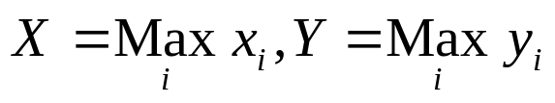
Multi-component control
Up to 255 image components
  Color, spectral bands, channels
  Each consists of a rectangular array of samples.
  Samples of all components within an image must have the same sampling precision.
  May have different sample dimensions x_{i} by y_{i}.
Multiplexing based on “data unit”
  Sequential mode
  Interleaving mode
JPEG itself does not provide enough info for image representation, i.e., no aspect ratio, color space, acquisition characteristics.

Slide 11
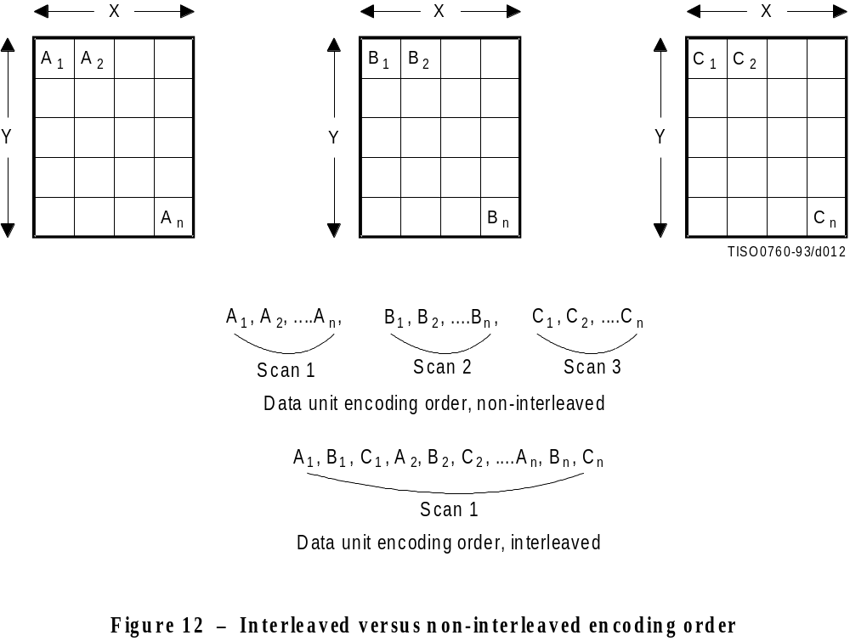

Slide 12
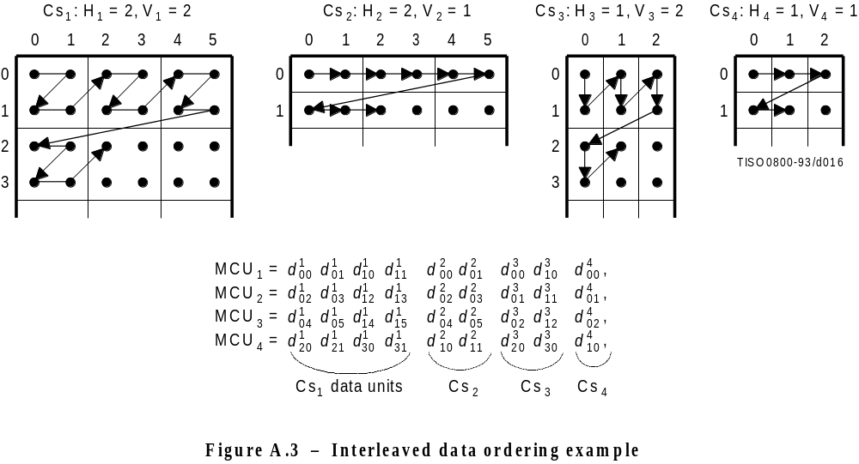
Component multiplexing
The maximum number of components to be interleaving is 4.
The maximum data unit in an MCU is 10.
H_{i}, V_{i}: horizontal and vertical sampling factors.

Slide 13
Color space conversion
RGB => YCbCr
  convert RGB color space to luminance and chrominance
Subsample in chrominance component
  due to visual perception, human is less sensible to chrominance
  YUV 4:2:0, 4:2:2, 4:4:0, 4:1:1:, 4:4:4 (even more flexible) are applicable in JPEG compression.
YCbCr domain
RGB Domain
Conversion Equation
  Y = 0.299 R + 0.587 G + 0.114 B
  Cb = -0.1687 R - 0.3313 G + 0.5 B +128
  Cr = 0.5 R - 0.4187 G - 0.0813 B + 128

Slide 14
Color space conversion (conti.)
4:2:0
4:2:2
CbCr sample
(chrominance)
RGB or Y sample
(luminance)
4:4:4

Slide 15
Discrete cosine transform (DCT)
Convert the time (spatial) domain signal into frequency domain.
Each output number (called DCT coeff) stands for the amplitude of one of the 64 unique 2D spatial frequencies.
88 84 83 84 85 86 83 82 86 82 82 83 82 83 83 81 82 82 84 87 87 87 81 84 81 86 87 89 82 82 84 87 81 84 83 87 85 89 80 81 81 85 85 86 81 89 81 85 82 81 86 83 86 89 81 84 88 88 90 84 85 88 88 81
675 1 -6 2 -2 0 5 -5 -4 1 2 1 5 1 -3 0 2 3 4 6 -2 2 1 5 -3 -1 0 2 0 -2 2 -4 4 3 1 -1 -2 1 -3 1 1 -2 0 -3 2 -1 1 1 3 0 -1 0 -1 -1 0 -2 -1 -1 -5 5 2 -2 2 0
DCT

Slide 16
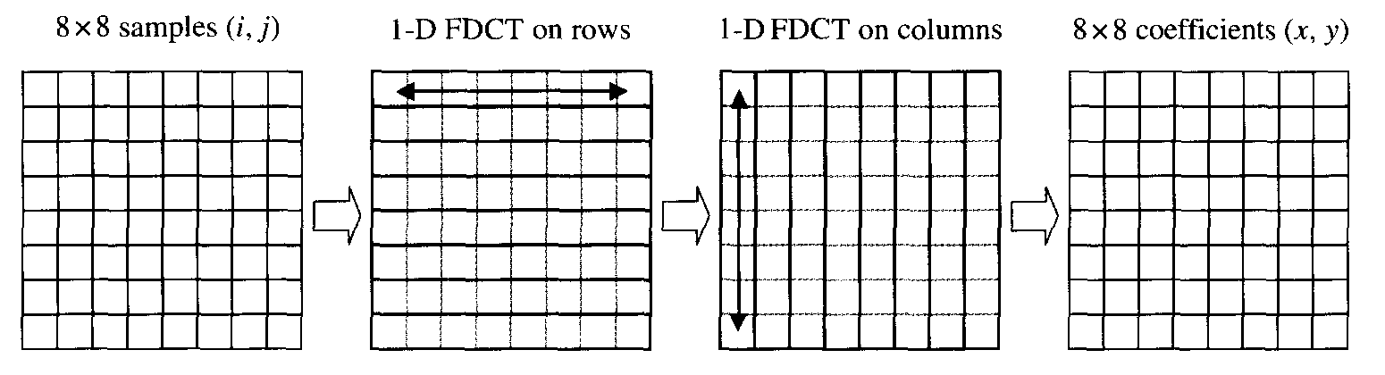
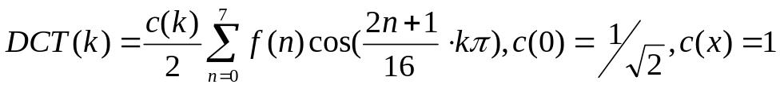
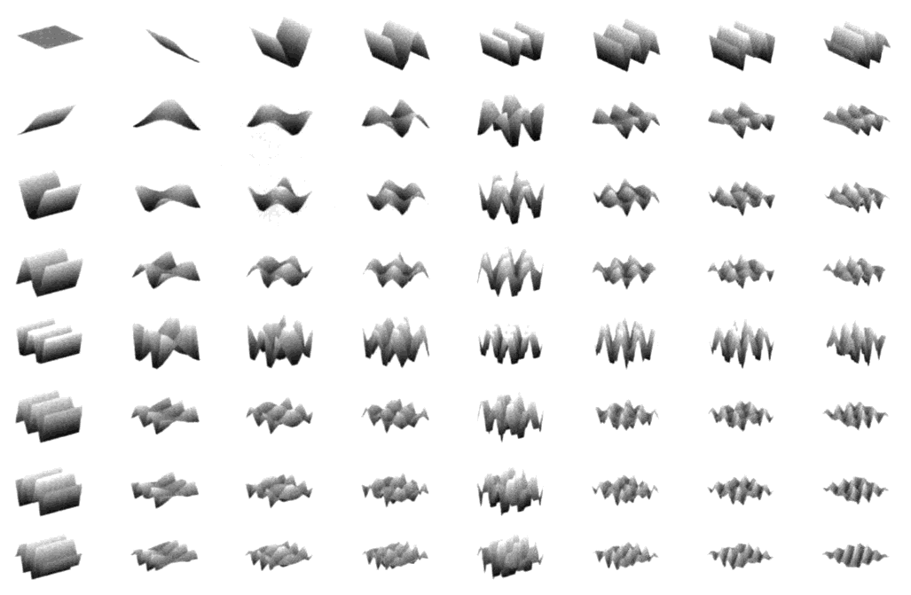
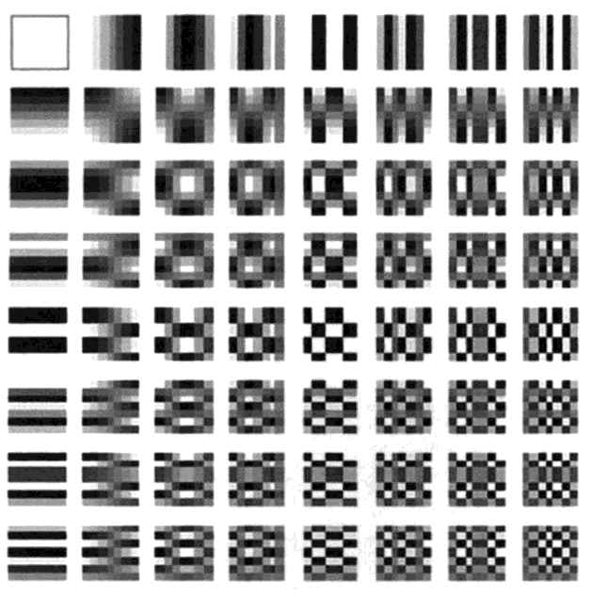
DCT basis functions
Effectively transform data into an easy compression form
Can be efficiently
implemented
  Separable transforms
  Symmetry of cosine operations

Slide 17
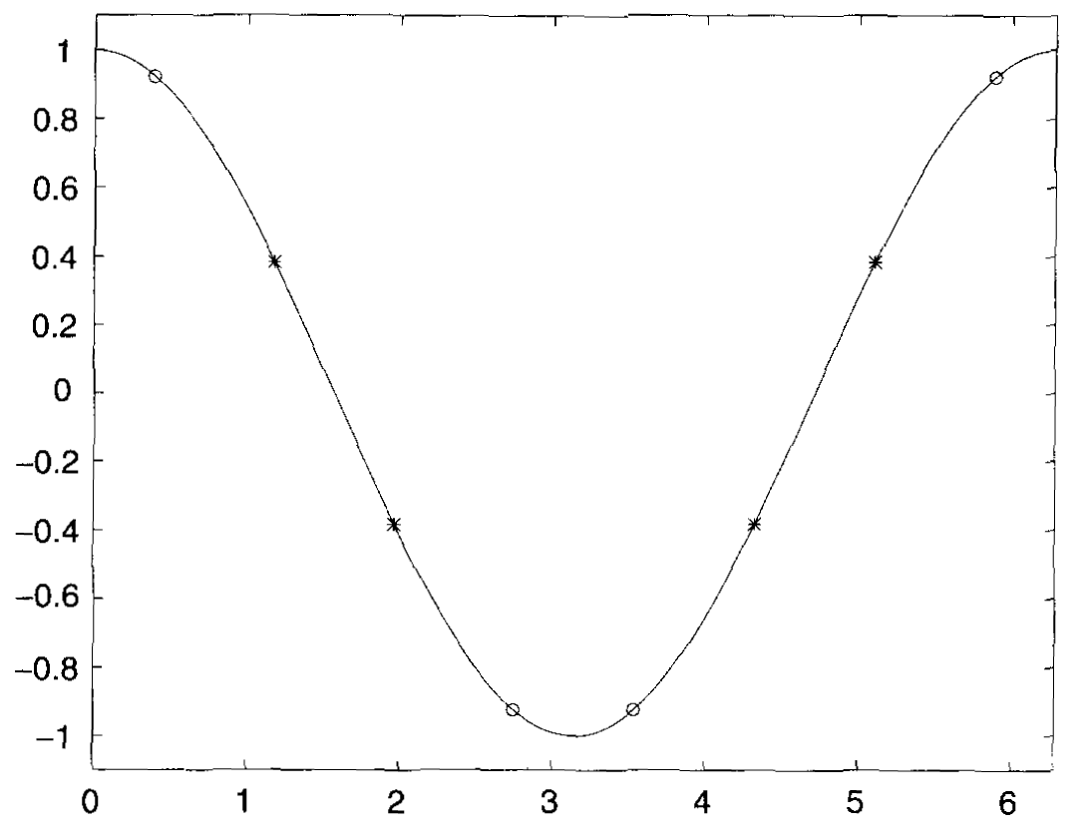
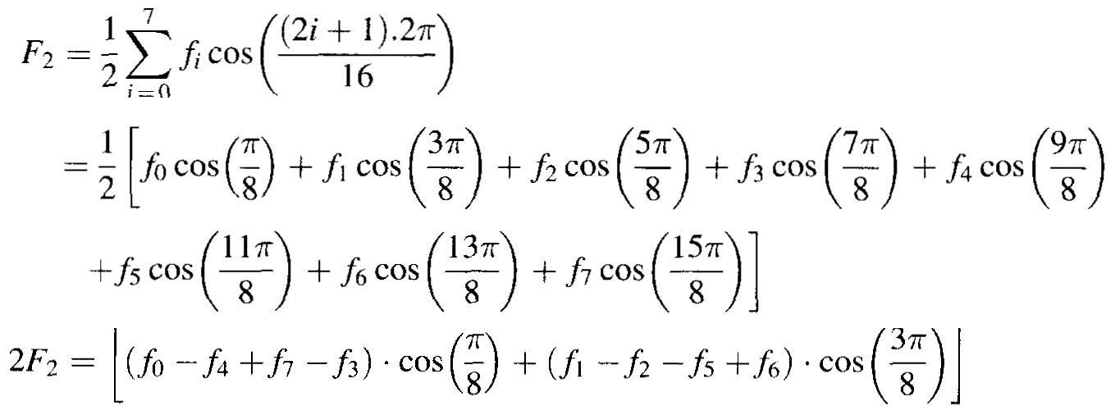
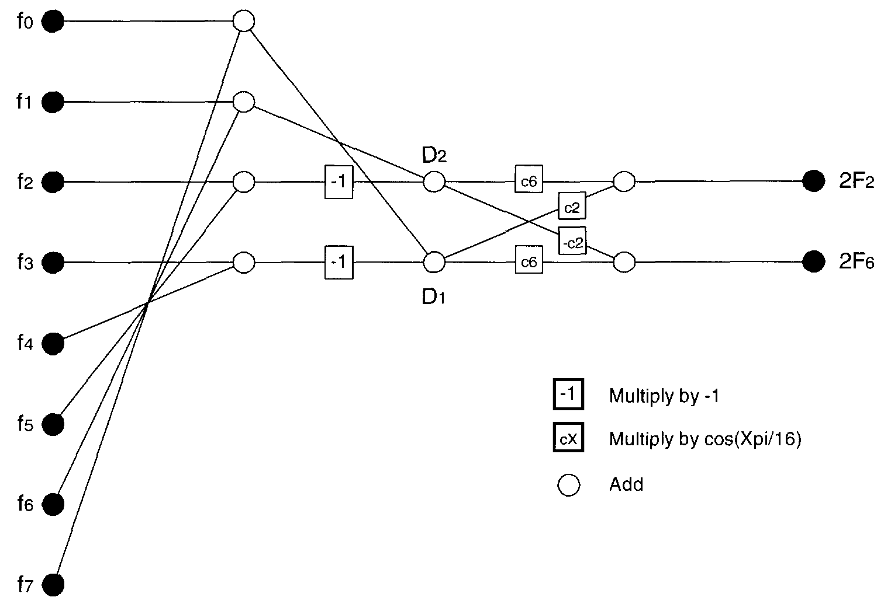
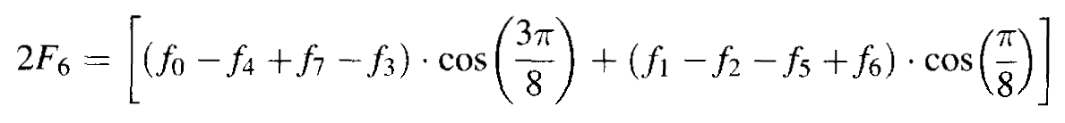
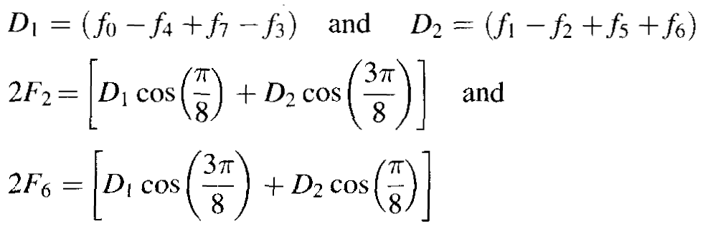
Fast DCT algorithms
Flowgraph algorithm

Slide 18
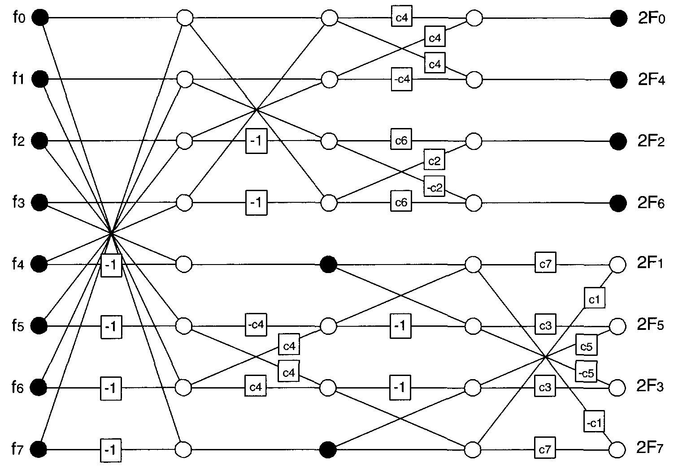
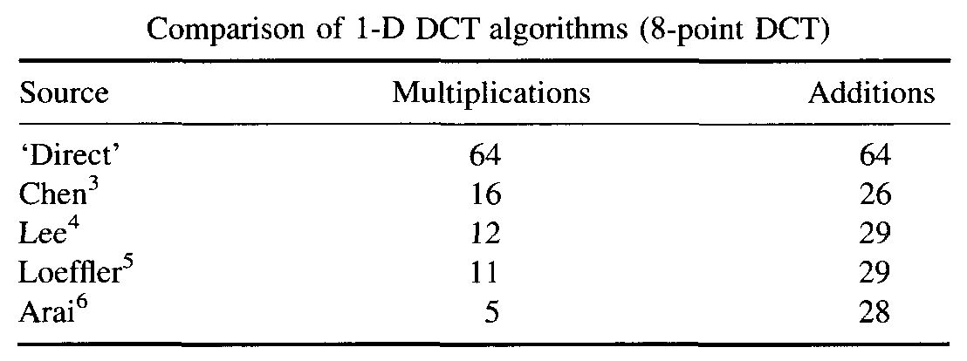
Fast DCT algorithms

Slide 19
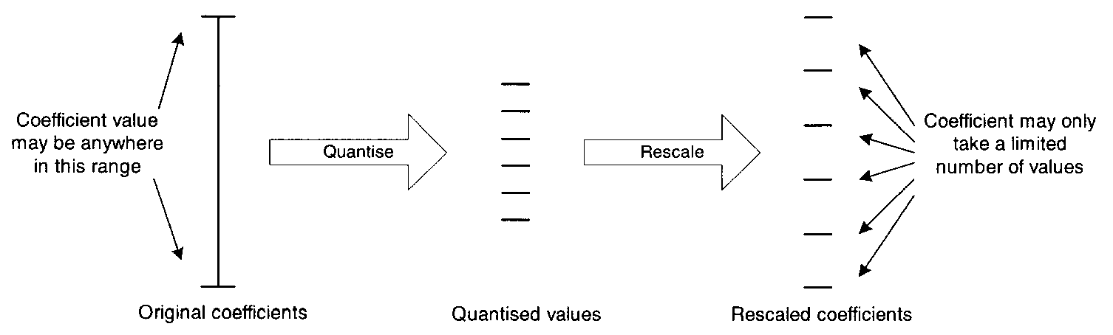
Quantization
Transform stage is usually followed by quantization stage.
Linear quantization v.s. non-linear quantization
Scalar quantization v.s. vector quantization
Lloyd-Max quantizer, pdf-optimized quantizer, rate-distortion optimized quantizer

Slide 20
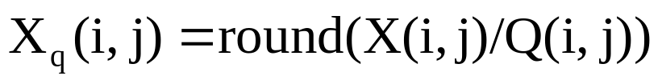
Quantization
Integer from 1 to 255, should be chosen as perceptual threshold or just noticeable difference.
  lossy data compression technique
  e.g. 4/2 = 2, 5/2 = 2
Suggested tables are generated for CCIR-601 images.
  YUV 422, 6 times the screen width
675 1 -6 2 -2 0 5 -5 -4 1 2 1 5 1 -3 0 2 3 4 6 -2 2 1 5 -3 -1 0 2 0 -2 2 -4 4 3 1 -1 -2 1 -3 1 1 -2 0 -3 2 -1 1 1 3 0 -1 0 -1 -1 0 -2 -1 -1 -5 5 2 -2 2 0
168 0 -1 0 0 0 1 -1 -1 0 0 0 1 0 0 0 0 0 1 1 0 0 0 1 0 0 0 0 0 0 0 -1 1 0 0 0 0 0 0 0 0 0 0 0 0 0 0 0 0 0 0 0 0 0 0 0 0 0 -1 1 0 0 0 0
Quant

Slide 21
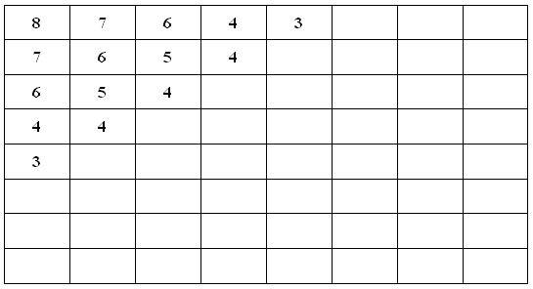
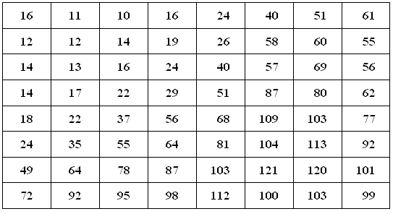
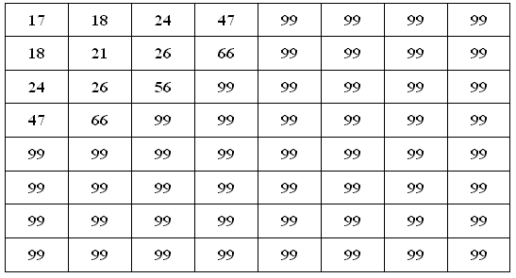
Bit allocation via quantization
A process to determine which coefficients should be retained and how coarsely each retained coefficient should be quantized.
  Zonal coding
  Threshold coding
Zonal bit allocation
Luma quantization matrix
Chroma quantization matrix

Slide 22
ZigZag scan
Placing low-frequency coefficients before high-frequency coefficients.
  make all zeros to be concatenated
  Facilitate entropy coding and get more compression gain
168 0 -1 0 0 0 1 -1 -1 0 0 0 1 0 0 0 0 0 1 1 0 0 0 1 0 0 0 0 0 0 0 -1 1 0 0 0 0 0 0 0 0 0 0 0 0 0 0 0 0 0 0 0 0 0 0 0 0 0 -1 1 0 0 0 0
Zigzag
168,0,-1,0,0,-1,0,0,0,0,1, 0,1,0,0,0,1,1,...,1,0,0,0,-1, 0,0,0,0,0,0,0,0,0,0

Slide 23
Run length coding
Run Length Encode
  Encode continuous zeros and a nonzero into a symbol
RLE
168,0,-1,0,0,-1,0,0,0,0,0,1, 0,1,0,0,0,1,1,...,1,0,0,0,-1, 0,0,0,0,0,0,0,0,0,0
(1,-1) (2,-1) (5,1) (1,1) (3,1) (0,1) (9,1) (0,-1) (14,1) (4,-1) (0,1) (3,-1) EOB

Slide 24
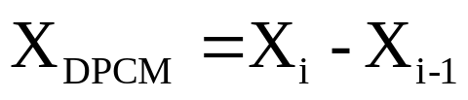
Differential Pulse Coded Modulation
Since large DC coefficients frequently occupied a significant percentage of bitrate, special treatment is worthwhile.
DPCM is adopted: using the previous QDC to predict the current QDC.
One predictor for each component.
DC=138
DC=140
DPCM
138 => 2 => -4 => 2
DC=136
DC=138

Slide 25
Variable Length Codes
Up to 4 different entropy coding tables, 2 for baseline.
The same table must be used to encode all samples within a component.
Codeword design and constraints
  At most 16 bit in length
  Code length should be decided by its appearing probability, e.g., short codeword representing the high frequency event.
  All-1-bits codeword is reserved as a prefix for longer codeword.
Fixed length code
Variable length code
A : 00
B : 01
C : 10
A : 1
B : 01
C : 00
ABAC
00010010
101100
8 bits
6 bits

Slide 26
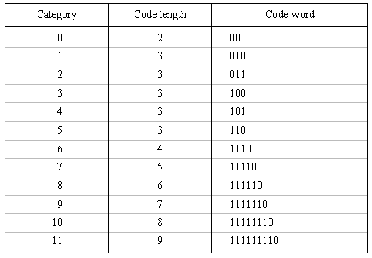
Huffman table coding
BITS: a 16-byte list, giving the number of codes for each code length. (0, 1, 5, 1, 1, 1, 1, 1, 1, 0, …)
HUFFVAL: a list of 8-bit symbol values assigned to each codeword. (0, 1, 2, 3, 4, …, 11)
…

Slide 27
Arithmetic Codes
In Huffman (VLC) code, a one-to-one mapping between symbols and codewords exists.
AC assigns a single variable-length code to a source composed of N symbols (N is variable)
The compression ratio of AC is better than that of HC, but the computation is higher, too.

Slide 28
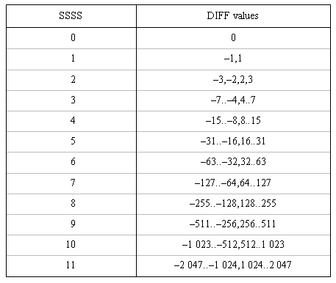
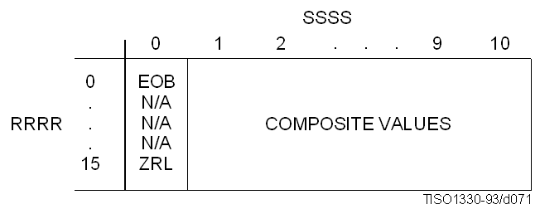
DC and AC composite symbols
DC (SSSS + DIFF)
  SSSS: Magnitude of DC prediction residue.
  DIFF: sign and less significant bits.
AC (ZZ + DIFF)
  ZZ: run length (RRRRSSSS)
  DIFF: sign and LSB of level

Slide 29

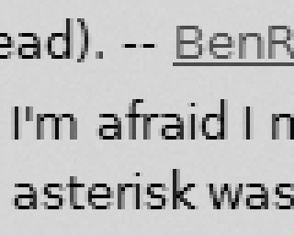
Blocking Artifacts
DCT induces some artifacts
  Blurring
    truncation of “high frequency” coefficient
  Graininess
    coarse quantization of some coefficients
  blocking artifacts
    each block is processed independently with different quantization strategies
How to solve it?
  overlapping block
  post processing

Slide 30
JPEG bitstream markers
Marker segment starts with an identifiable code 0xff01~0xfffe
  SOI, EOI: start/end of image
  SOF: Start of frame
  SOS: start of scan
  DHT: define Huffman table
  DAC: define arithmetic coding conditionings
  DQT: define quantization table
  DRI: define restart interval
  DNL: define number of lines
  DHP: define hierarchical progression
  RST: restart marker (modulo 8)
  APP, COM
Stuffing byte “00” is inserted after “ff” in the entropy-coded data segments.
Stuffing bytes “ff” can be inserted before any valid marker.

Slide 31
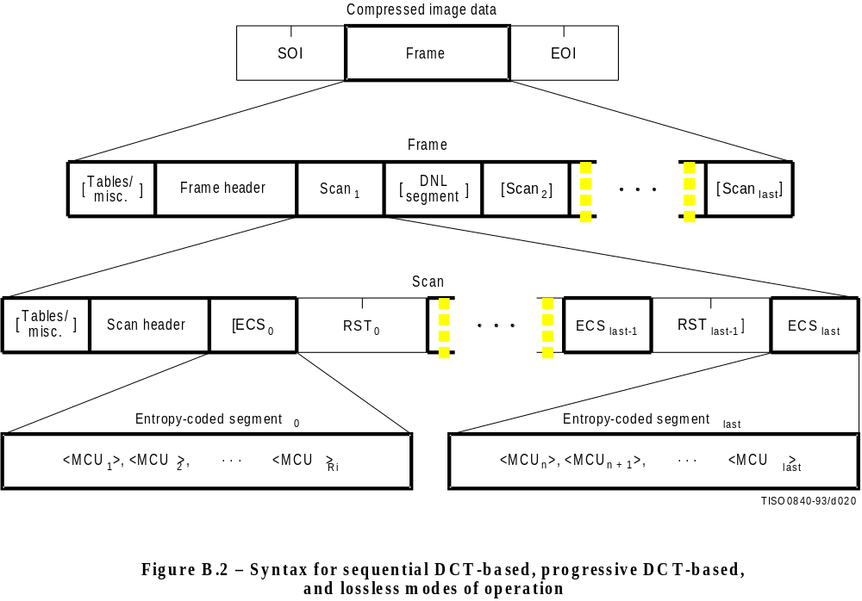

Slide 32
JPEG Decoder
DCT based decoder
Entropy
decoder
Dequantizer
IDCT
01100...
Compressed
Image data
Huffman Table
specifications
Quant Table
specifications
Reconstructed
Image data

Slide 33
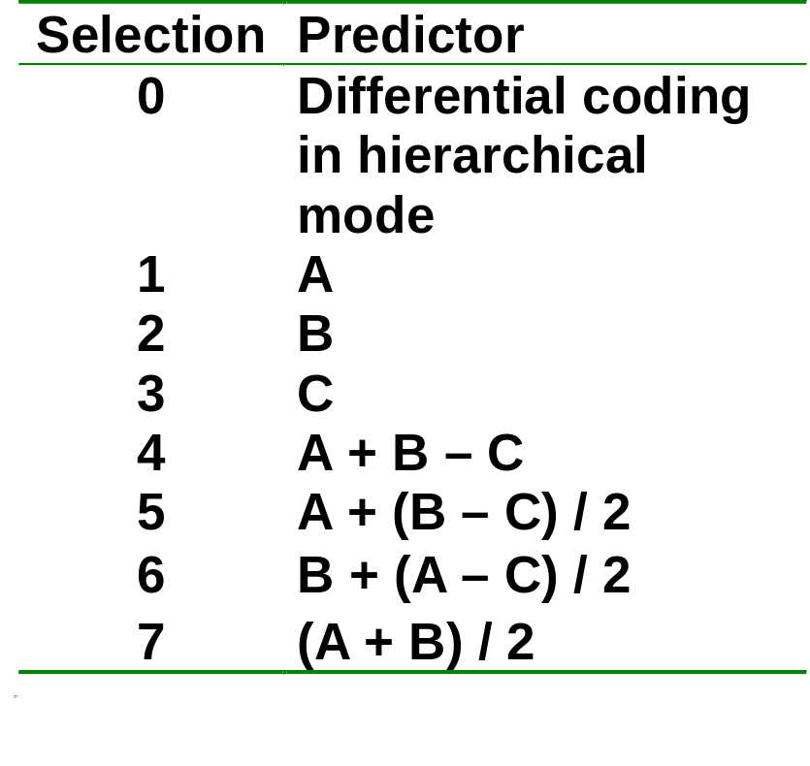
JPEG Lossless
DCT-based lossless mode is hard to define as a practical standard.
Typically 2:1 compression ratio.
No DCT, no quantization, predictive coding and entropy coding only.
Perform better than JBIG (>6 bits/sample)
C
B
A
X

Slide 34
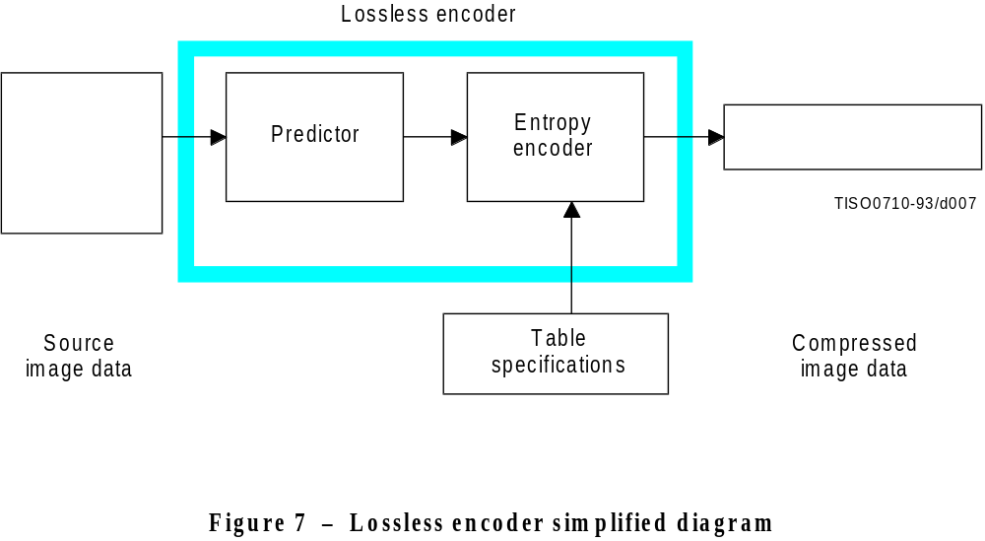

Lossless encoding chart
010100111000…

Slide 35
JPEG Progressive
Encode the DCT coefficients in multiple passes (scans)
A image sized frame buffer is required (16bits/sample)
Spectral
Selection
LSB
.
.
.
Successive
approximation
MSB
0 1 … 63

Slide 36
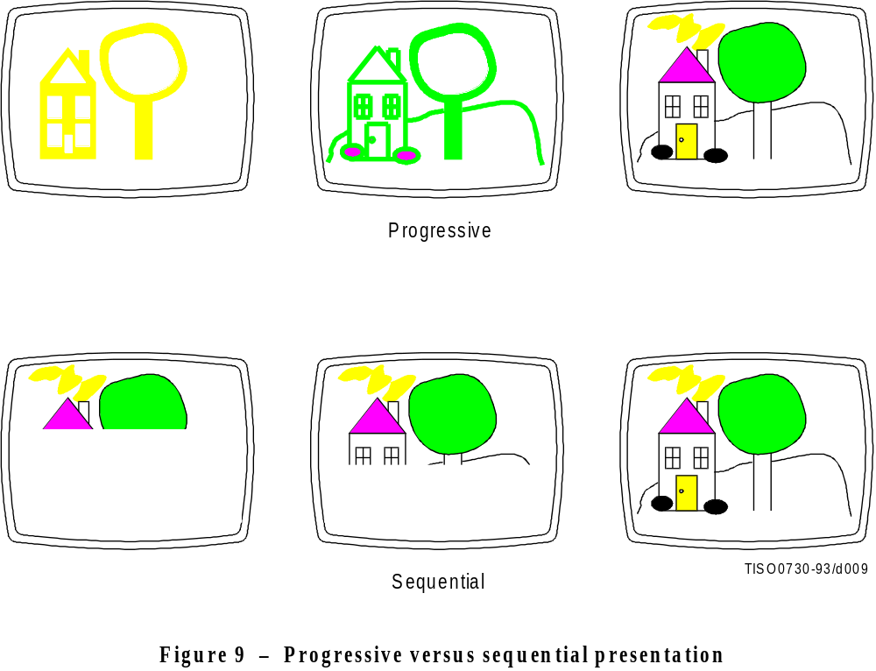

Slide 37
JPEG Hierarchical
Requirement for display in different resolution devices
Pyramid structure
  top layer is upsampled and treated as as the prediction for the next layer
  The bilinear interpolation filter is specified.
  each layer is coded using sequential, progressive or lossless mode
    All DCT-based coding
    All lossless coding
    All DCT-based coding except for the last layer
Non-differential frame
Differential frame

Slide 38
Differential frame coding
Differential frame
  No level shift
  DC is coded without prediction.
  Extra bit of precision in the Huffman code table.

Slide 39
JPEG File Interchange Format (JFIF)
Features:
  Uses JPEG compression
  Standard color space: one or three components. For three components, YCbCr
  APP0 marker used to specify display units, X pixel density, Y pixel density, thumbnail
  APP0 marker also used to specify JFIF extensions (JFXX)
  APP0 marker also used to specify application-specific information

Slide 40
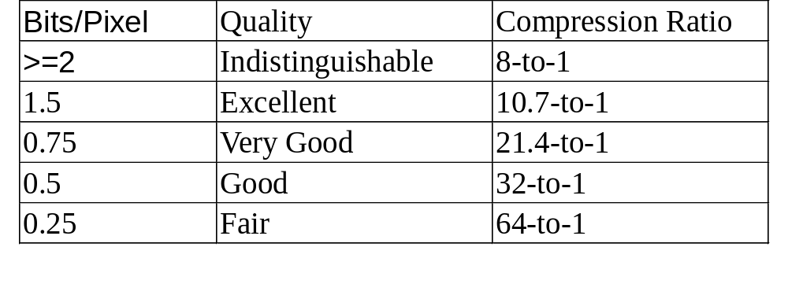
JPEG Performance
Guideline for compression and picture quality
Vary significantly according to image characteristics and scene content.

Slide 41
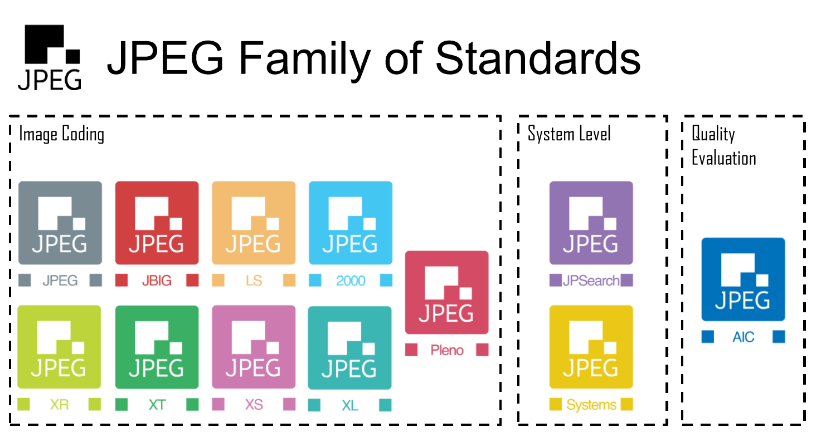

Slide 42
JPEG family
JPEG 2000 – Wavelet based scalable video coding
JPEG LS – Lossless coding, low complexity
JPEG XR – Microsoft Windows Media family, HD photo
JPEG XT – Backward compatible, support HDR, lossless/Alpha channel
JPEG XS – Light-weight / low latency
JPEG XL – State-of-the-art compression, extension for long-term
JPEG Pleno – Light-field, Point Cloud, Holography coding

Slide 43
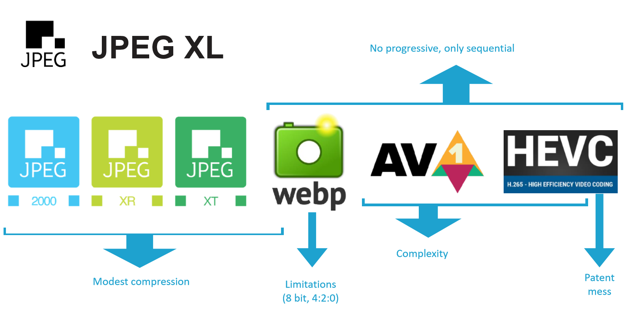
Who is next after JPEG?

Slide 44
Reading assignment
Mandatory
  Chapter 7: Transform coding, Video codec design
Suggested:
  Chapter 19: DPCM and transform coding/Chapter 20: Still image compression standards, Digital video processing.
  Gregory K. Wallace, “The JPEG still picture compression standard,” IEEE trans on consumer electronics, Feb 1992.

Slide 45
Homework
3. JPEG does not provide default Huffman/quantization tables, and the adopted tables should be embedded into DHT/DQT segment. Some JPEG coders have their default tables (maybe the same as that given in Annex K).
  1) Write a rate reduction program to replace the Huffman tables with new ones, which are adaptive to the statistics of coded symbols. Is the JPEG photo taken by your digital camera well compressed? Try your program on it!
  2) Write a quality/rate adjusting program to replace the quantization tables (maybe a new one w.r.t that used by MPEG-4) and quantized DCT coefficients.

